Slide 1

CRYPTOCURRENCY DATA PIPELINE
Real-time Streaming & Batch Processing
Using AWS Cloud Services
Kavya Rana
Big Data Engineer
Date: 13-01-2025

Slide 2
Agenda
Presentation Overview
Introduction & Problem Statement
Gold Layer Modeling
Business challenges & solution requirements
Star Schema design
Technology Stack
Dimension & Fact tables
Data Quality & Testing
19 AWS services & technologies overview
Architecture Overview
DQDL framework & validation rules
CI/CD & Infrastructure
Batch Architecture (Daily Processing)
CodePipeline, CodeBuild & automation
Streaming Architecture (Real-Time)
Step Functions Orchestration
QuickSight Dashboards
Data Source Integration
Batch Pipeline (Historical analytics)
CoinGecko API & data collection
Streaming Pipeline (Real-time insights)
Medallion Architecture
Challenges & Lessons Learned
Bronze (Raw data)
Technical obstacles & solutions
Silver (Cleaned & validated)
Future Enhancements
Gold (Analytics-ready)
Roadmap & scalability improvements
File formats (JSON, Parquet)

Slide 3

Problem Statement
The Cryptocurrency Data Challenge
⚠️ MANUAL DATA COLLECTION IMPOSSIBLE
💰 BUSINESS IMPACT
100+ coins × 1440 minutes/day = 144,000 manual checks
Missed Opportunities: $50,000+ daily
Max 5-10 coins, 8 hours/day → Miss 95% of opportunities
Bad Decisions: 20% error rate
Operational Cost: 15+ hours/week
⚠️ DATA QUALITY ISSUES
Competitive Gap: Competitors react faster
APIs return inconsistent data (missing fields, duplicates)
15-20% bad data → Wrong decisions → Financial losses
✓ WHAT'S NEEDED
✓ Process 100+ coins continuously (batch)
⚠️ LATENCY KILLS OPPORTUNITIES
✓ Monitor priority coins in real-time (streaming)
Manual checks: 15-30 minute delays
✓ Ensure 99%+ data quality validation
Bitcoin can swing 10% in minutes. Price already moved.
✓ Deliver sub-second latency
✓ Scale effortlessly (10 to 10,000 coins)
⚠️ CANNOT SCALE
Markets operate 24/7
Start with 10 coins → need 100+ within months
15,000+ cryptocurrencies with extreme volatility
Manual processes break. No way to add without rebuilding.

Slide 4
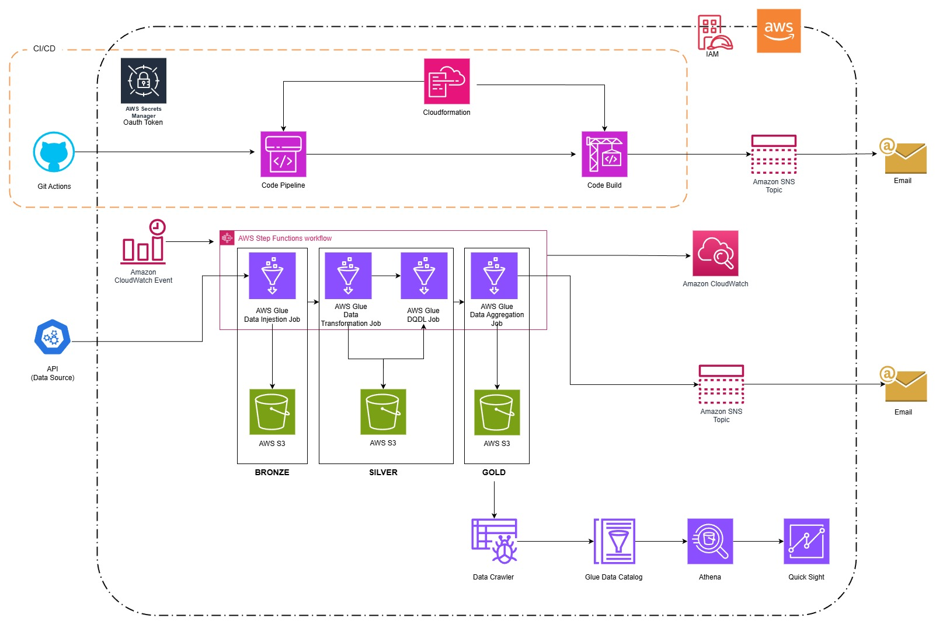
Batch Architecture
Historical Data - Medallion Architecture

Slide 5
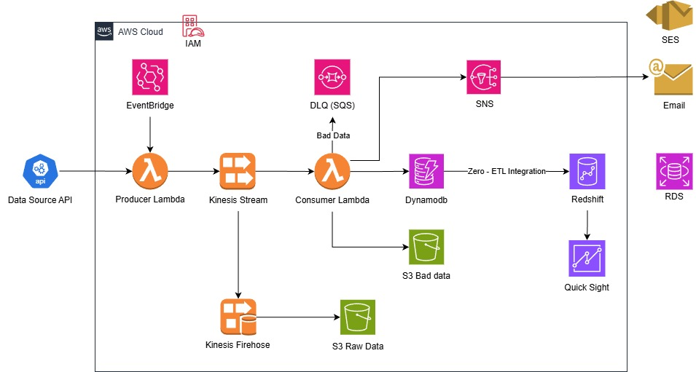
Streaming Architecture
Real-Time Data - Lambda Architecture

Slide 6
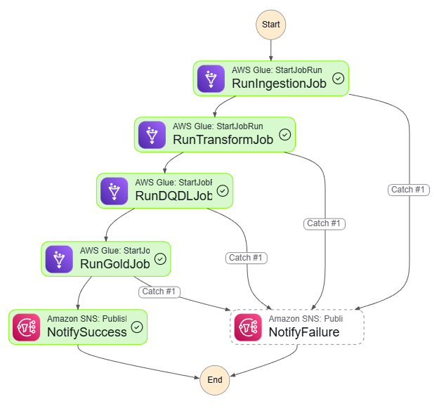
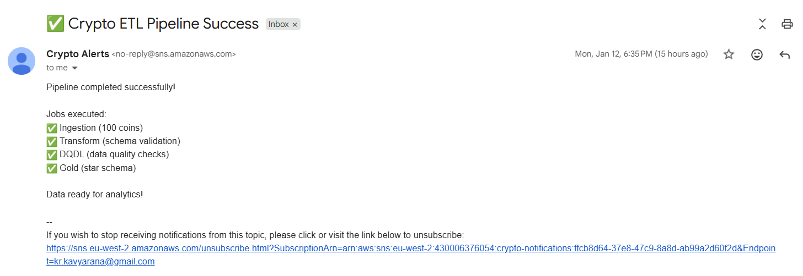
Step Function – workflow Orchestration
PURPOSE:
• Orchestrates 4-job batch pipeline workflow
• Bronze → Transform → DQDL → Gold
• Visual state machine for easy monitoring

Slide 7
Star Schema
DIM_COINS
- coin_key (PK)
- coin_id
- symbol
- name
FACT_CRYPTO_DAILY
- fact_key (PK)
- coin_key (FK)
- date_key (FK)
- coin_id
- date
- current_price
- market_cap
- market_cap_rank
- total_volume
- high_24h
- low_24h
- price_change_24h
-price_change_percentage_24h
- circulating_supply
- total_supply
DIM_DATE
- date_key (PK)
- date
- year
- month
- day
- quarter
- week_of_year
- month_name
- day_name
- is_weekend

Slide 8

Data Source Integration
CoinGecko API - Real-Time Cryptocurrency Data
API ENDPOINT
FILE FORMATS
api.coingecko.com/api/v3/coins/markets
BRONZE LAYER
Parameters:
Format: JSON (raw from API)
vs_currency=usd, order=market_cap_desc
No transformation, full load
per_page=100, page=1
SILVER LAYER
Format: Parquet (Snappy)
KEY DATA FIELDS
Incremental with bookmarks
coin_id, symbol, name, current_price
GOLD LAYER
market_cap, total_volume, price_change_24h
market_cap_rank, ath, atl, circulating_supply
Format: Parquet (optimized)
Incremental, aggregated
DATA COLLECTION
Batch: CloudWatch scheduled (daily)
DATA CHARACTERISTICS
Streaming: EventBridge (every 5 min)
100+ cryptocurrencies per extraction
Volume: 100 coins per API call
2-3KB per coin (JSON format)
60-70% compression with Parquet
Daily batch: 300KB raw to 90KB compressed

Slide 9
Medallion Architecture
Bronze → Silver → Gold Data Layers
🥉 BRONZE LAYER
Purpose: Raw JSON from CoinGecko API, no transformations
Raw Data Ingestion
Load Type: Full load (overwrites existing data daily)
Format: JSON files stored in S3
Data Quality: None - stores everything as received from API
🥈 SILVER LAYER
Purpose: Cleaned, deduplicated, validated data
Cleaned & Validated
Load Type: Incremental with Glue bookmarks (timestamp-based)
Format: Parquet (compressed, columnar storage)
Transformations: Remove nulls, handle missing fields, add metadata columns (ingestion_date, processing_time)
🥇 GOLD LAYER
Purpose: Business-ready aggregated metrics and analytics
Business Analytics
Load Type: Incremental updates based on Silver changes
Format: Parquet (optimized for QuickSight queries)
Transformations: Aggregate metrics, price trends, market cap rankings, 24h change calculations
✓ DATA QUALITY
Validation Rules: Completeness (no null IDs), Uniqueness (no duplicate coins), Data type checks
DQDL Framework
Applied At: Silver layer via dedicated DQDL Glue job
Action on Failure: Log errors to CloudWatch, store bad records in S3, continue processing good data

Slide 10

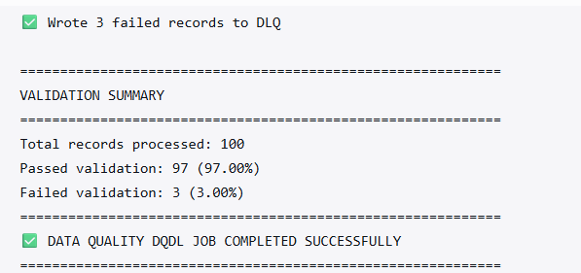
Data Quality & Testing
DQDL Framework - Ensuring 99%+ Data Accuracy
VALIDATION FRAMEWORK
ERROR HANDLING
Tool: AWS Glue DQDL (Data Quality Definition Language)
Failed Records: Logged to CloudWatch with details
Native: Built into AWS Glue, no external libraries
Bad Data (Batch): Stored in separate S3 bucket for review
Applied: Dedicated DQDL Glue job in batch pipeline
DLQ (Streaming): SQS captures streaming pipeline failures
Processing: Continue with valid data, don't halt pipeline
VALIDATION RULES
Completeness: coin_id, symbol, name must not be null
QUALITY METRICS
Uniqueness: No duplicate coin_id in single batch
✓ 99%+ data accuracy achieved
Data Types: Numeric fields validated (price, market_cap)
✓ Automated validation on every batch run
Range Checks: Prices must be positive, realistic values
✓ Real-time alerts via SNS for critical failures
✓ Zero manual intervention required
DQDL GLUE JOB
✓ Complete audit trail in CloudWatch logs
Runs as 3rd job in Step Functions workflow
Reduced error rate from 20% to less than 1%
Validates Silver layer data before Gold aggregation
Generates quality metrics and reports

Slide 11

CI/CD & Infrastructure
Automated Deployment with CloudFormation & GitHub Actions
GITHUB ACTIONS PIPELINE
CLOUDFORMATION USAGE
Trigger: Push to main/master branch
Purpose: Define CodePipeline and CodeBuild
Connection: GitHub OAuth integration
Scope: CI/CD infrastructure only
CodePipeline: Automated build and deploy
Not Used For: Main AWS services (S3, Glue, Kinesis, Lambda) - these were created manually for learning purposes
CodeBuild: Compiles Glue job scripts
DEPLOYMENT SCOPE
BENEFITS ACHIEVED
✓ Glue job scripts (Bronze, Silver, Gold, DQDL)
✓ Automated deployments on code push
✓ Step function state machine definitions
✓ Version control for all pipeline code
✓ DQDL validation rules
✓ Reduced deployment time from 30min to 5min
✓ Configuration files (YAML)
✓ Zero manual script uploads to S3
✓ SNS notifications for deployment status
INFRASTRUCTURE APPROACH
DEPLOYMENT FLOW
Manual: AWS infrastructure created manually
Git Push → GitHub → CodePipeline → CodeBuild → S3 (Glue Scripts) → Email Notification
Automated: Code deployment via CodePipeline

Slide 12
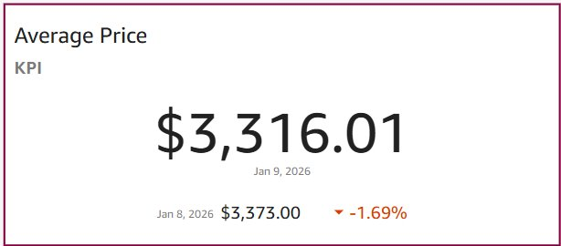
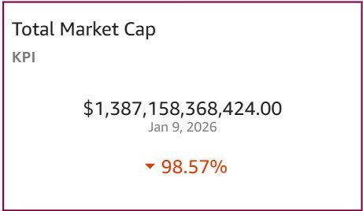
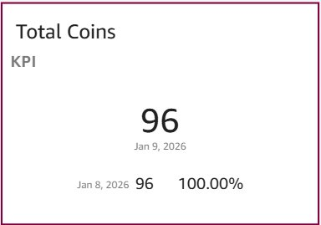
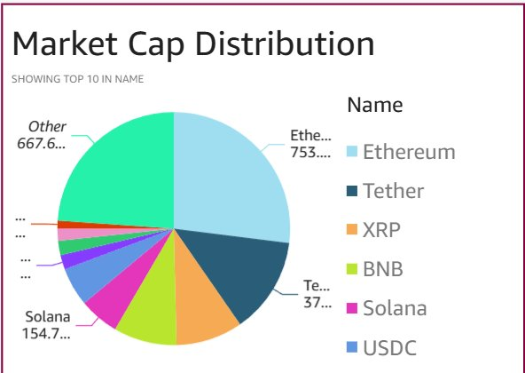
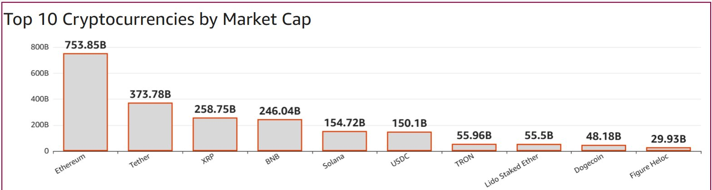
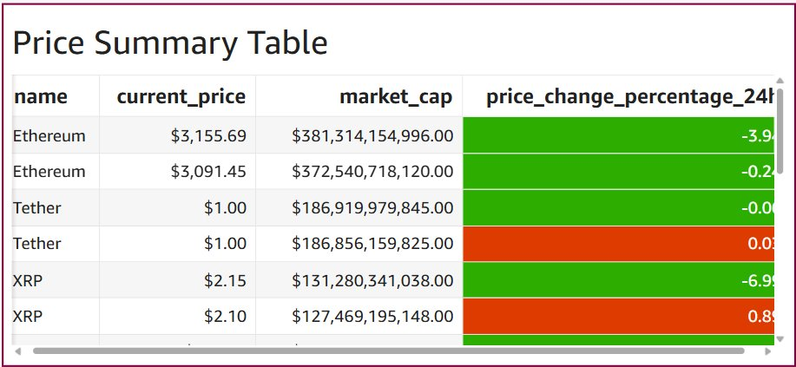
QuickSight Dashboards
Real-Time Analytics & Visualization
BATCH PIPELINE - HISTORICAL DATA

Slide 13
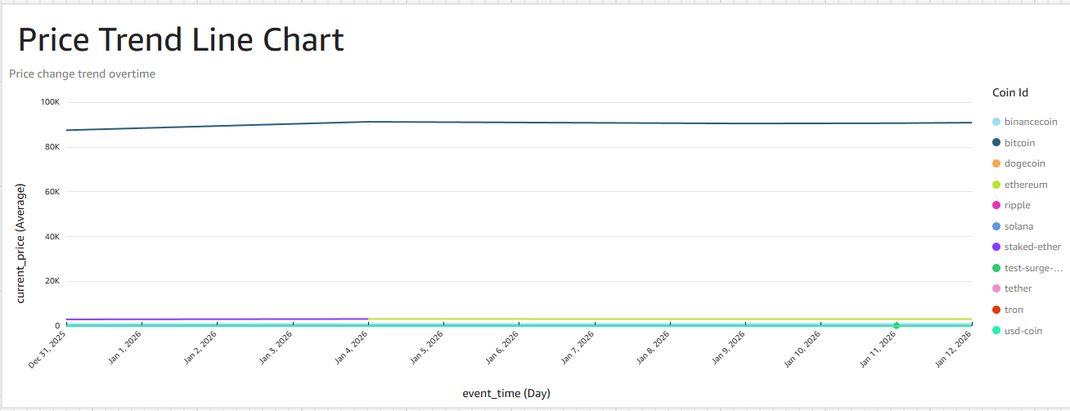
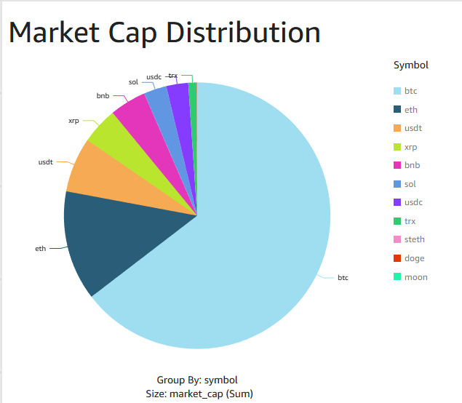
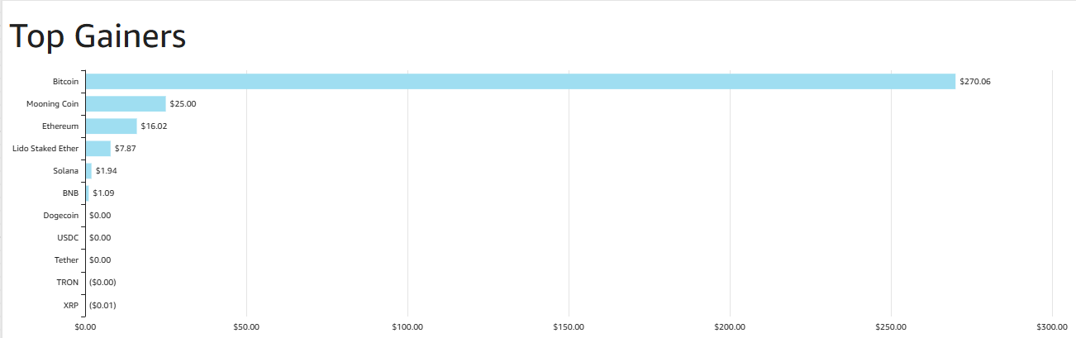
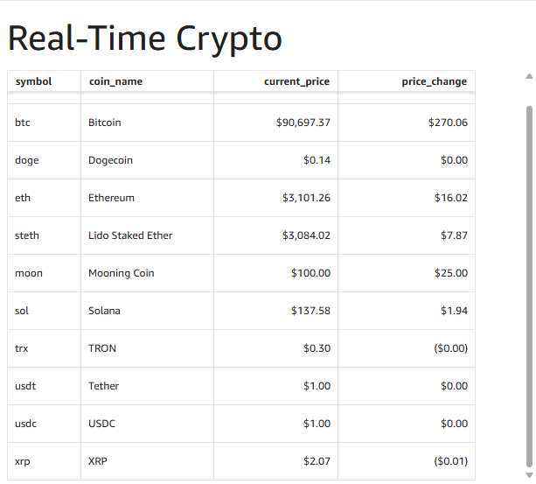
QuickSight Dashboards
Real-Time Analytics & Visualization
⚡ STREAMING PIPELINE - REAL-TIME

Slide 14
Technology Stack
19 AWS Services & Technologies
Category
Tools / Technologies Used
Data Source
CoinGecko API (REST, JSON)
Ingestion
AWS Glue, Lambda, EventBridge, CloudWatch Events
Streaming
Kinesis Data Streams, Kinesis Firehose
Error Handling
Amazon SQS (Dead-Letter Queue)
Storage
Amazon S3 (Bronze, Silver, Gold layers)
Processing & Data Quality
AWS Glue (Spark), DQDL, Glue Bookmarks
Orchestration
AWS Step Functions
Metadata & Catalog
AWS Glue Data Catalog
Database & Warehouse
DynamoDB, Redshift (Zero-ETL), Athena
Visualization
Amazon QuickSight
Monitoring & Alerts
CloudWatch, Amazon SNS
Security
AWS IAM
Infrastructure as Code
AWS CloudFormation
CI/CD
CodePipeline, CodeBuild, GitHub
Languages & Formats
Python, PySpark, JSON, Parquet, YAML

Slide 15
Challenges
Key Technical Obstacles & Their Solutions
⚠️ DQDL RULE DESIGN
Issue: Designing effective DQDL rules for cryptocurrency data edge cases
Validation Logic Setup
Solution: Analyzed API data patterns, created comprehensive rule set covering nulls, duplicates, and range validations
⚠️ QUICKSIGHT REFRESH
Issue: QuickSight dashboards showed stale data despite pipeline running successfully
Dashboard Not Updating
Solution: Configured automatic refresh schedules and checked athena queries
⚠️ STREAMING FAILURES
Issue: Lambda timeout errors during high-volume processing from Kinesis stream
Consumer Lambda Issues
Solution: Increased Lambda timeout, optimized batch size, implemented DLQ for failed records
⚠️ GLUE BOOKMARKS
Issue: Understanding bookmark behavior for incremental processing in Silver/Gold layers
Incremental Load Logic
Solution: Studied AWS documentation, tested with small datasets, added timestamp-based filtering
⚠️ PYDEEQU VERSION MISMATCH
Issue: PyDeequ 1.1.0 incompatible with PySpark 3.3 and AWS Glue 4.0
Library Dependency Issue
Solution: Switched to AWS Glue DQDL (native, no dependencies)

Slide 16
Future Enhancements
Planned Improvements & Next Steps
MACHINE LEARNING INTEGRATION
ADDITIONAL DATA SOURCES
Price prediction models using historical data
Social media sentiment analysis (Twitter, Reddit)
Anomaly detection for unusual price movements
News articles and market analysis feeds
Trading volume from multiple exchanges
ENHANCED MONITORING
ADVANCED ANALYTICS
CloudWatch dashboards for pipeline metrics
Correlation analysis between cryptocurrencies
Cost optimization tracking and alerts
Portfolio optimization recommendations
Historical backtesting framework
FULL IaC IMPLEMENTATION
SCALABILITY IMPROVEMENTS
Terraform/CloudFormation for all AWS resources
Process 1000+ cryptocurrencies (currently 100)
Environment management (dev, staging, prod)
Reduce streaming latency to sub-second
One-click deployment of entire infrastructure
Implement data partitioning strategies

Slide 17

Questions & Discussion
PROJECT HIGHLIGHTS
✓ 19 AWS Services Integrated
✓ 99%+ Data Quality Achieved
✓ Batch & Streaming Architectures
✓ CI/CD Pipeline
✓ Medallion Data Architecture
✓ Production-Ready Solution

Slide 18
Thank You

